Slide 1

TAIBAH UNIVERSITY
Faculty of Science
Department of Math.
جامعة طيبة
كلية العلوم
قسم الرياضيات
Probability and Statistics for Engineers
STAT 301
Second Semester 1432/1433
Teacher : Osama Hosam

Slide 2
Random Variables and Probability Distributions
Chapter 3

Slide 3
Contents
Concept of Random Variable
Discrete Probability Distribution

Slide 4
Concept of Random Variable
In a statistical experiment, it is often very important to allocate numerical values to the outcomes.
Example
Experiment: testing two components.
(D=defective, N=non-defective)
Sample space: S={DD,DN,ND,NN}

Slide 5
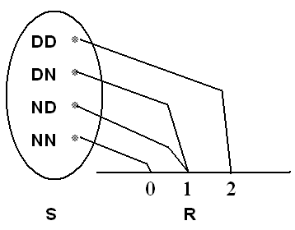
Concept of Random Variable
Let X = number of defective components when two components are tested.
Assigned numerical values to the outcomes are:
Sample point (Outcome) | Assigned Numerical Value (x)
DD | 2
DN | 1
ND | 1
NN | 0
Notice that, the set of all possible values of the random variable X is {0, 1, 2}.

Slide 6
Concept of Random Variable
Definition 3.1:
A random variable X is a function that associates each element in the sample space with a real number (i.e., X : S → R.)
Notation
" X “ (capital letter) denotes the random variable .
" x " (small letter) denotes a value of the random variable X.

Slide 7
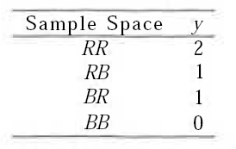
Concept of Random Variable(Ex1)
Two balls are drawn in succession without replacement from an urn containing 4 red balls and 3 black balls. The possible outcomes and the values y of the random variable: Y, where V is the number of red balls, are

Slide 8
Concept of Random Variable(Ex2)
Let X be the random variable defined by the: waiting time, in hours, between
successive speeders spotted by a radar unit.
The random variable X takes on all
values x for which x > 0.

Slide 9
Types of Random Variable
Discrete Random Variable:
A random variable X is called a discrete random variable if its set of possible values is countable, i.e.,
x ∈ {x₁, x₂, …, x_{n}} or x ∈ {x₁, x₂, …}
In most practical problems:
A discrete random variable represents count data, such as the number of defectives in a sample of k items.

Slide 10
Types of Random Variable
Continuous Random Variable:
A random variable X is called a continuous random variable if it can take values on a continuous scale, i.e.,
x ∈ {x: a < x < b; a, b ∈ R}
In most practical problems:
A continuous random variable represents measured data, such as height.

Slide 11
Probability Distributions (Discrete )
3.2 Discrete Probability Distributions
A discrete random variable X assumes each of its values with a certain probability.
Example:
Experiment: tossing a non-balance coin 2 times independently.
H= head , T=tail
Sample space: S={HH, HT, TH, TT}

Slide 12
Probability Distributions (Discrete )
Suppose
P(H) = ½P(T) ⇔ P(H)=1/3 and P(T)=2/3
Let X= number of heads
Sample point (Outcome) | Probability | Value of X (x)
HH | P(HH)=P(H) P(H)=1/3×1/3 = 1/9 | 2
HT | P(HT)=P(H) P(T)=1/3×2/3 = 2/9 | 1
TH | P(TH)=P(T) P(H)=2/3×1/3 = 2/9 | 1
TT | P(TT)=P(T) P(T)=2/3×2/3 = 4/9 | 0

Slide 13
Probability Distributions (Discrete )
The possible values of X are: 0, 1, and 2.
X is a discrete random variable.
Define the following events:
Event (X=x) | Probability = P(X=x)
(X=0)={TT} | P(X=0) = P(TT)=4/9
(X=1)={HT,TH} | P(X=1) =P(HT)+P(TH)=2/9+2/9=4/9
(X=2)={HH} | P(X=2) = P(HH)= 1/9

Slide 14
Probability Distributions (Discrete )
The possible values of X with their probabilities are:
x | 0 | 1 | 2 | Total
P(X=x)=f(x) | 4/9 | 4/9 | 1/9 | 1.00
The set of ordered pairs ( x , f(x) ) is called the probability function (probability distribution) of the discrete random variable X.

Slide 15
Probability Distributions (Discrete )
Definition 3.4:
The set of ordered pairs ( x , f(x) ) is a probability mass function, or probability distribution of the discrete random variable X if, for each possible outcome x,

Slide 16
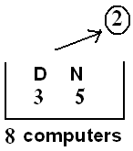
Prob. Distributions (Discrete ) (EX1)
A shipment of 8 similar microcomputers to a retail outlet contains 3 that are defective. If a school makes a random purchase of 2 of these computers, find the prob. Dist. for the number of defectives.

Slide 17
Prob. Distributions (Discrete ) (EX1)
Solution:
We need to find the prob. distribution of the random variable: X = the number of defective computers purchased.
Experiment:
selecting 2 computers at random out of 8:
n(S) = equally likely outcomes
The possible values of X are: x=0, 1, 2.

Slide 18
Prob. Distributions (Discrete ) (EX1)
Consider the events:

Slide 19
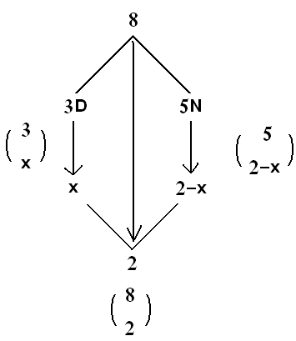
Prob. Distributions (Discrete ) (EX1)
In general, for x=0,1, 2, we have:

Slide 20
Prob. Distributions (Discrete ) (EX1)
The prob. distribution of X is:
x | 0 | 1 | 2 | Total
f(x)= P(X=x)
1.00
Hypergeometric Distribution

Slide 21
Contents
Cumulative Dist. Function of a discrete random variable
Continuous Prob. Distribution
Cumulative Dist. Function of a continuous random variable

Slide 22
Cumulative Distribution Function (CDF)
Definition 3.5:
The cumulative dist. function (CDF), F(x), of a discrete random variable X with the probability function f(x) is given by:
for −∞<x<∞

Slide 23
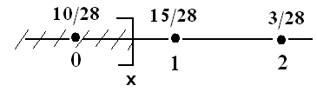
Cumulative Dist. Function (Ex 1)
Find the CDF of the random variable X with the probability function if the pmf of X is:
x | 0 | 1 | 2
f(x)

Slide 24
Cumulative Dist. Function (Ex 1)
Solution:
F(x) = P(X≤x) for −∞<x<∞
For x<0 : F(x)=0
For 0≤x<1: F(x)=P(X=0)=
For 1≤x<2: F(x)=P(X=0)+P(X=1)=
For x≥2: F(x)=P(X=0)+P(X=1) +P(X=2)

Slide 25
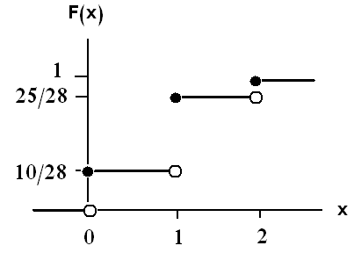
Cumulative Dist. Function (Ex 1)
The CDF of the random variable X is:

Slide 26
Cumulative Dist. Function (Ex 1)
Note:
F(−0.5) = P(X≤−0.5)=0
F(1.5)=P(X≤1.5)=F(1) =
F(3.8) =P(X≤3.8)=F(2)= 1
Result:
P(a < X ≤ b) = P(X ≤ b) − P(X ≤ a) = F(b) − F(a)
P(a ≤ X ≤ b) = P(a < X ≤ b) + P(X=a) = F(b) − F(a) + f(a)
P(a < X < b) = P(a < X ≤ b) − P(X=b) = F(b) − F(a) − f(b)

Slide 27
Cumulative Dist. Function
Result:
Suppose that the probability function of X is:
x | x₁ | x₂ | x₃ | … | x_{n}
F(x) | f(x₁) | f(x₂) | f(x₃) | … | f(x_{n})
Where x₁< x₂< … < x_{n}. Then:
F(x_{i}) = f(x₁) + f(x₂) + … + f(x_{i}) ; i=1, 2, …, n
F(x_{i}) = F(x_{i −1} ) + f(x_{i}) ; i=2, …, n
f(x_{i}) = F(x_{i}) − F(x_{i −1} )

Slide 28
Cumulative Dist. Function
In the previous example,
P(0.5 < X ≤ 1.5) = F(1.5) − F(0.5)
P(1 < X ≤ 2) = F(2) − F(1)

Slide 29
Continuous Probability Distributions
For any continuous random variable, X, there exists a non-negative function f(x), called the probability density function (p.d.f) through which we can find probabilities of events expressed in term of X.

Slide 30
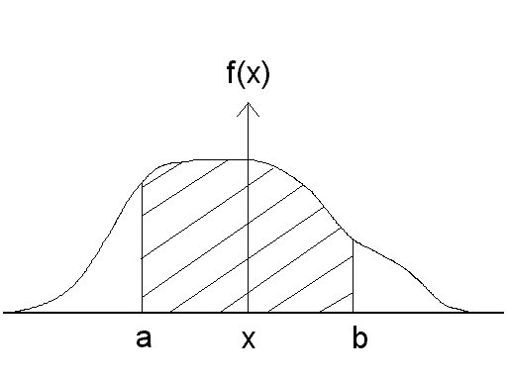
Continuous Probability Distributions
= area under the curve of f(x) and over the interval (a,b)
f: R → [0, ∞)
= area under the curve
of f(x) and over the
region A

Slide 31
Continuous Probability Distributions
Definition 3.6:
The function f(x) is a probability density function (pdf) for a continuous random variable X, defined on the set of real numbers, if:
∀ a, b ∈ R ; a ≤ b

Slide 32
Continuous Probability Distributions
Note:
We shall concern ourselves with computing prob. for various intervals of continuous random variables such as P(a < X < b),
P(W > c), and so forth.
Note that when X is continuous,
P(a ≤ X ≤ b)= P(a < X ≤ b)
= P(a ≤ X < b)
= P(a < X < b)

Slide 33
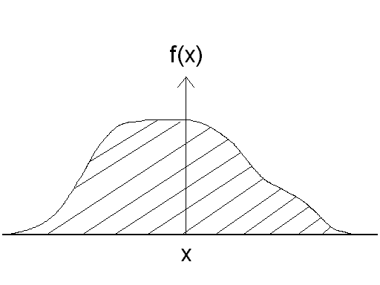
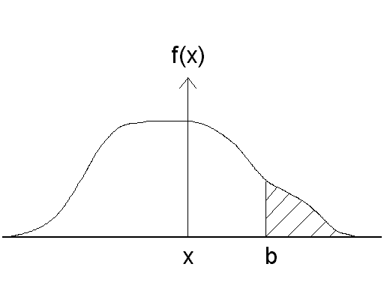
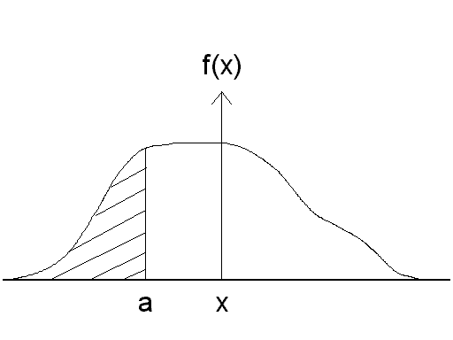

Slide 34
Continuous Probability Distributions
Example 3.6:
Suppose that the error in the reaction temperature, in ºC, for a controlled laboratory experiment is a continuous random variable X having the following probability density function:

Slide 35
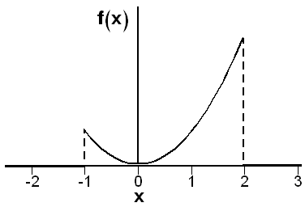
Continuous Probability Distributions
Solution:
X =the error in the reaction temperature in ºC.
X is continuous r. v.

Slide 36
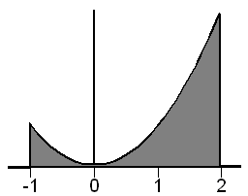
Continuous Probability Distributions
because f(x) is a quadratic function.

Slide 37
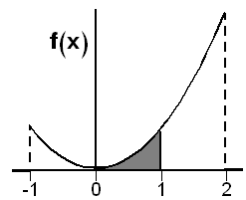
Continuous Probability Distributions

Slide 38
Cumulative Dist. Function
Definition 3.7:
The cumulative distribution function (CDF), F(x), of a continuous random variable X with probability density function f(x) is given by:
for −∞ <x<∞
Result:

Slide 39
Cumulative Dist. Function (Example)
Example 3.6:
Suppose that the error in the reaction temperature, in ºC, for a controlled laboratory experiment is a continuous random variable X having the following probability density function:

Slide 40
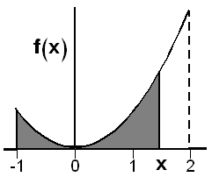
Cumulative Dist. Function (Example)
Solution:

Slide 41
Cumulative Dist. Function (Example)

Slide 42
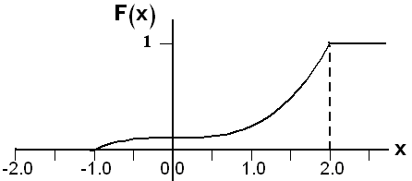
Cumulative Dist. Function (Example)
Therefore, the CDF is:

Slide 43
Cumulative Dist. Function (Example)

Slide 44
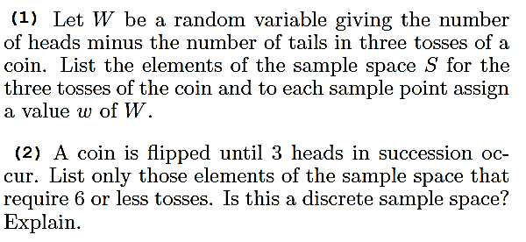
Exercises

Slide 45
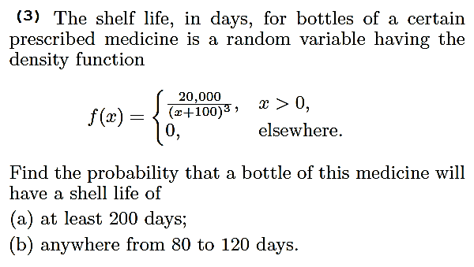
Exercises

Slide 46
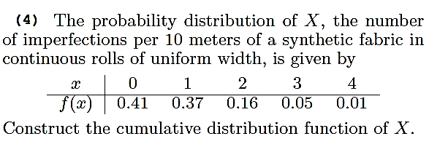
Exercises

Slide 47
The End

